Slide 1

CS 131: semester project (Anti-Virus Software)
By David G. De Loera

Slide 2

Why Anti-Virus Software?
The world is becoming more digitalized everyday that means that cyber related crimes will continue to grow.
Cyber criminals usually don’t face their consequences because they are efficient at what they do.
Everyday people go through one form of being hacked whether it’s their social security or their bank account that’s being used for faulty transactions.
Cyber criminals not only take what they want, they’re also are building more experience as they go.

Slide 3
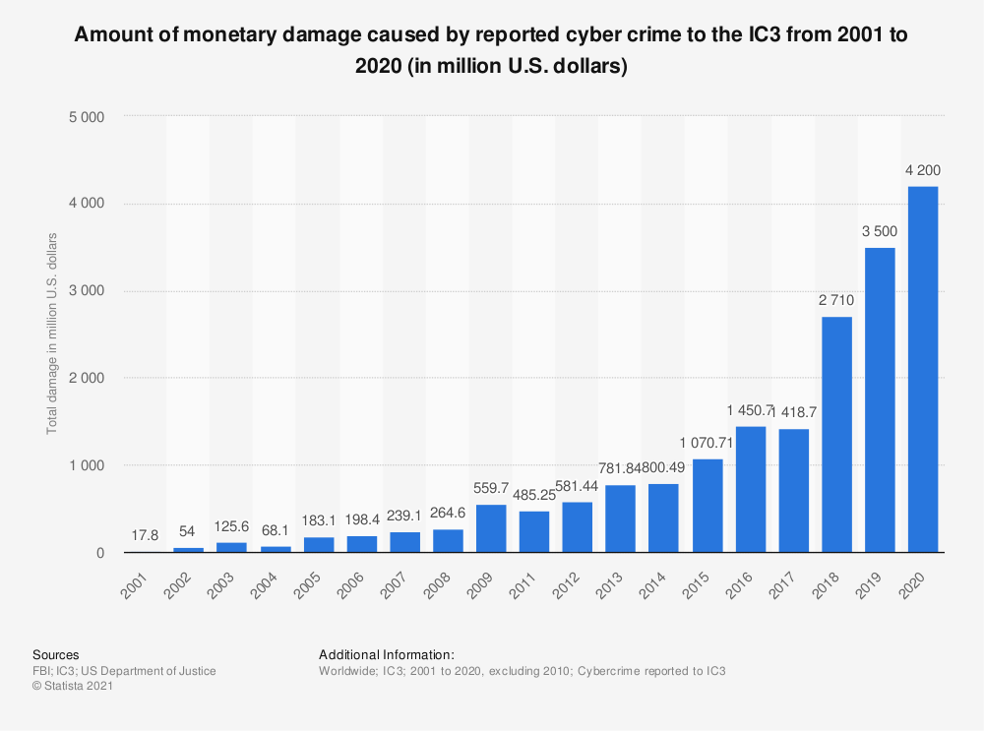
Damage done By Cyber Crimes
Notes:
IC3: Internet Crime Complaint Center

Slide 4

Best Anti-Virus Software
There are many types of anti-virus software in the market, but I will show you one of best that I personally use everyday and like because of their friendly user interface.
This software program is affordable and should be in every home and workplace that uses computers.

Slide 5

Anti-Virus Software
Easy to use
Encrypts all private information
Friendly user-interface
Affordable
Continues to invest money for research for better cryptography which means better encryption
Can protect Mac/Windows/Android devices
Provides VPN
Can add multiple web browser protection

Slide 6
References
Statista. (2021, March 18). IC3: total damage caused by reported cyber crime 2001–2020. Retrieved December 1, 2021, from https://www.statista.com/statistics/267132/total-damage-caused-by-by-cyber-crime-in-the-us/
Bitdefender. (n.d.). Bitdefender - Global Leader in Cybersecurity Software. Retrieved December 1, 2021, from https://www.bitdefender.com

